Slide 1

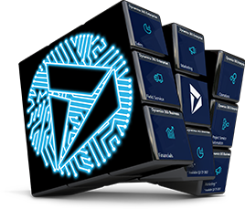


Best practices for performance improvements

Slide 2

Social
www.365portal.org
Twitter: @Dyn365Community
Linkedin: @365-Saturday
Hashtags
#D365SaturdayVictoria #365Saturday #msdyn365
Wifi: TBC
Pass: TBC
Community.Dynamics365.com

Slide 3


Dynamics 365 Community
Join the Dynamics 365 Community, where you can interact with your peers and Microsoft Dynamics 365 experts. You can get answers to your questions by posting questions in the forums, starting discussions, reading informative blog articles, and watching how-to videos.
https://community.dynamics.com
Benefits
Participate and help build a pool of knowledge that’s accessible by members at any time!
Expand your network by engaging with peers
Involvement
Need help? Ask questions and join in on business or technical discussions in the forums
Share your expertise by hosting a blog or syndicating your existing blog
Recognition
Earn badges for participation and engagement
Become a Community Star and earn appreciation from peers
Join Today!
Get answers, find inspiration, connect with others
Free membership
Any questions? Email us at dlcommed@Microsoft.com

Slide 4
INTRO
Summary
Optimisation – Why ?
Optimisation – How ?
App Checker

Slide 5
INTRO

Slide 6










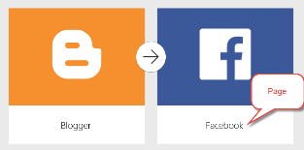
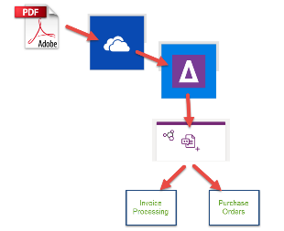




INTRO
Éric Sauvé – Solution Architect
Passionate about the Power Platform and actively sharing to the Business Applications community as @ZePowerDiver
D365 CE & PowerApps Solution Architect
At XRM Vision since 2015
TDGi Community Lead
Power Platform Happy Hour – Montreal founder and organizer
xRM Montreal Meetup Organizer
Sea Diver

Slide 7
OPTIMIZATION – WHY?

Slide 8
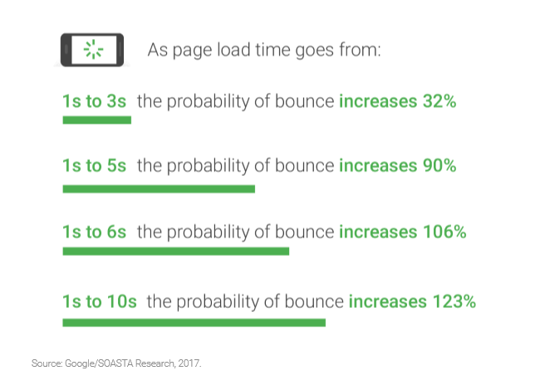
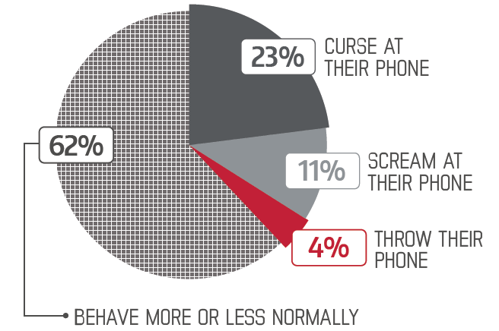
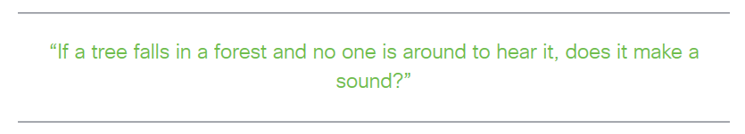
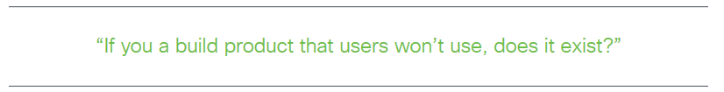
OPTIMIZATION – WHY?
User adoption
Consider: User Adoption vs. Customer experience
User Adoption is driven by value and by the experience – ensure that it’s a positive one!
Apps and web pages must respond in an instant or your adoption rate will drop
* Radware software

Slide 9
OPTIMIZATION – HOW?

Slide 10
OPTIMIZATION – HOW?
Review and consider
Initial loading steps – what to do when?
How is the data loaded and when?
When possible – use the Concurrent() call
Analyze – use Fiddler
Consider Static Data
Multiple screen inter-dependencies
How many controls on your screen?
Have images – can you compress?

Slide 11
APP CHECKER

Slide 12
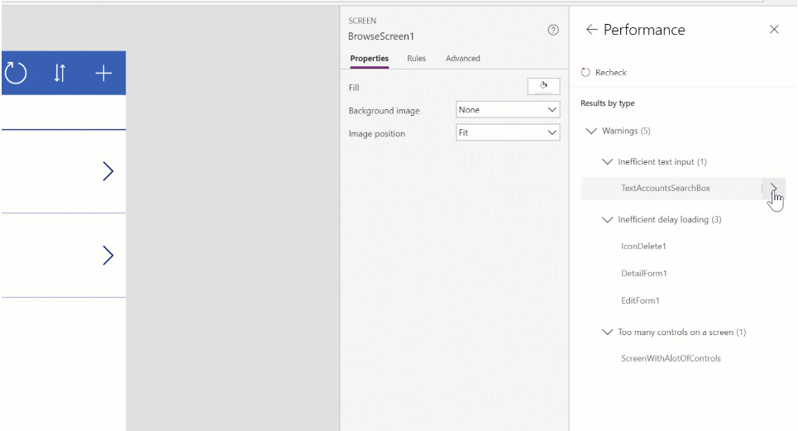
APP CHECKER
Performance Optimization Tips
Inefficient delay loading
Text input controls
Number of controls on a screen
More to come

Slide 13
Q&A

Slide 14
Feedback
We really value your feedback. Log-in to the 365portal event page and click on the session title.
Make sure you have added the session to your schedule and you have checked in.
You can now leave feedback which will help the speaker and improve our future events for the community.

Slide 15
